Slide 1
RETAIL SALES ANALYTICS
Bicycle & Bike Analysis using Excel, SQL, Python and Power BI
Project focus
• End-to-end retail sales analysis from raw transactional data to an interactive dashboard.
• Covers data cleaning, SQL querying, Python EDA / RFM and Power BI reporting.

Slide 2
1. Project Overview
From task brief → analysis → dashboard
CONTEXT
Problem Statement
• Retail businesses need to track sales performance, understand customer behavior and identify growth opportunities.
• The project builds an end-to-end analytics solution from raw transactional data.
OBJECTIVES
• Analyze sales performance and trends
• Identify high-value customers and product patterns
• Support targeted customer segmentation
• Monitor inventory and product performance
• Deliver an interactive management dashboard
Vinsup Skill Academy | Retail Sales Analytics Project
2

Slide 3
2. End-to-End Analytics Workflow
Multi-tool pipeline
Excel
SQL
Python
Power BI
01
02
03
04
Clean & prepare data
Store, join & query
EDA ,RFM
Visualize & report
• Data cleaning and processing the data
• SQL joins, aggregations, filters and segmentation
• Python Pandas with visualization for EDA
• Power BI modeling, KPIs, slicers and interactive reporting
Vinsup Skill Academy | Retail Sales Analytics Project
3

Slide 4
3. Phase 1 — Excel: Data Cleaning & Preparation
Foundation of the pipeline
KEY TASKS
Cleaning & Transformation
• Standardize column headers across customers, orders and products
• Remove duplicate records
• Handle missing values
• Convert dates and numeric columns to correct types
• Use VLOOKUP / XLOOKUP to merge product information
• Build a basic pivot table for sales by category
• Export cleaned CSV files for SQL import
Vinsup Skill Academy | Retail Sales Analytics Project
4

Slide 5
4. Phase 2 — SQL: Database & Querying
Relational analysis layer
Data Loading
Joins & Aggregation
• Create tables from the ERD structure
• Import cleaned CSV files into SQL / MySQL Workbench
• Join orders, order_items and products
• Calculate sales by store and other business summaries
REQUIRED OUTPUTS
• Customer spending brackets and final customer_segments table
• Revenue by store / staff and product-level performance
• Low-stock list for products
• Relational dataset ready for Python and Power BI
Vinsup Skill Academy | Retail Sales Analytics Project
5

Slide 6
5. Phase 3 — Python & ML
Analysis and customer segmentation
1. Load Data
2. Exploratory Analysis
3. RFM
• Use pandas.read_sql() to pull orders, order_items and customers into DataFrames
• Use df.describe(), df.info() and df.value_counts()
• Create basic charts with Matplotlib / Seaborn
• Recency = days since last order
• Frequency = number of orders
• Monetary = total purchase value
PIPELINE
RFM data + segment label → export to SQL customer_segments → import into Power BI for visualization
Vinsup Skill Academy | Retail Sales Analytics Project
6

Slide 7
6. Phase 4 — Power BI: Dashboard Requirements
Task-to-dashboard mapping
REQUIRED VISUALS
Sales Overview
Top Products
Customer Analysis
Store Map
• Sales over time • monthly trend • total orders
• Revenue or quantity by product
• Purchase patterns by city / state
• Geographic sales distribution
Low Stock Alert
Staff Performance
Customer Segments
Interactivity
• Products below stock threshold
• Revenue per staff member
• Segment distribution + segment revenue
• Slicers: status • category • store / segment
Vinsup Skill Academy | Retail Sales Analytics Project
7

Slide 8
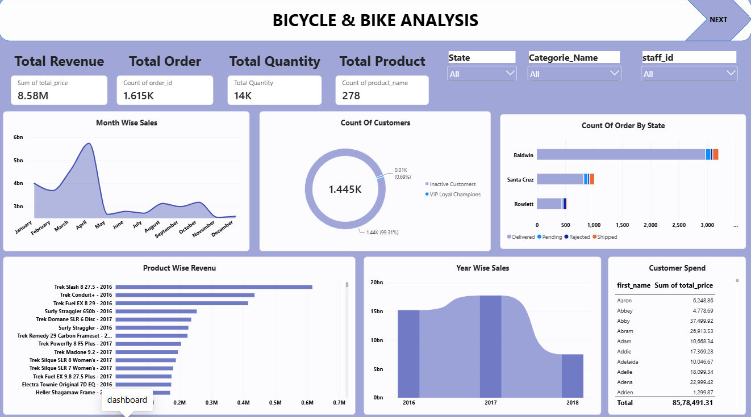
7. Power BI Dashboard — Overview
Submitted dashboard image
Vinsup Skill Academy | Retail Sales Analytics Project
8

Slide 9
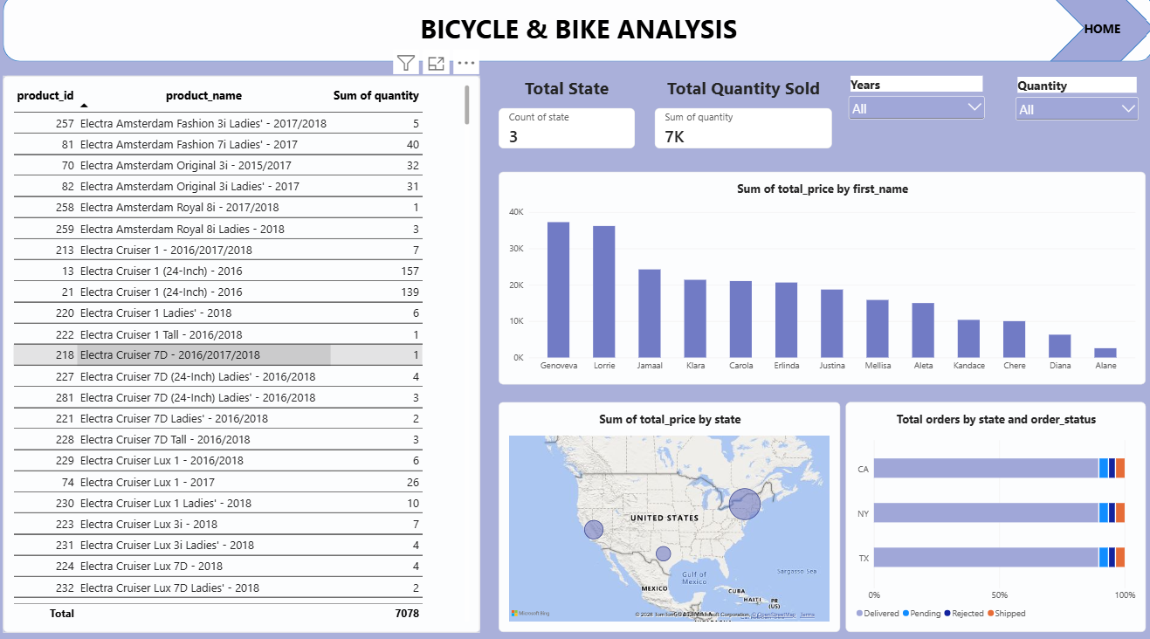
8. Power BI Dashboard — Product & Customer Detail
Submitted dashboard image
Vinsup Skill Academy | Retail Sales Analytics Project
9

Slide 10
9. Dashboard Highlights
Observed from the submitted dashboard
HEADLINE METRICS
Total Revenue
Total Orders
Total Quantity
Total Products
Customers
8.58M
1.615K
14K
278
1.445K
Sales Trend
Product & Customer View
Geography & Status
• Monthly sales rise to a visible peak around April in the submitted overview page.
• The dashboard also includes year-wise sales for 2016–2018.
• Product-wise revenue highlights the highest-revenue bike entries.
• Customer spend and customer-count visuals support customer-level analysis.
• State-level order visuals compare California, New York and Texas.
• Order status is split into Delivered, Pending, Rejected and Shipped.
Vinsup Skill Academy | Retail Sales Analytics Project
10

Slide 11
11. Conclusion
End-to-end retail analytics
SUMMARY
Raw transactional data → clean data → relational analysis → customer analytics → interactive Power BI reporting
Business Value
Analyst Skills Demonstrated
Next Step
• Centralizes sales, customer, product and geographic views
• Makes KPI monitoring and pattern discovery faster
• Excel • SQL • Python • Power BI
• EDA • RFM • ETL • Data Cleaning
• Use the dashboard to support management review and deeper analysis of segments, products, stores and inventory
THANK YOU
Vinsup Skill Academy | Retail Sales Analytics Project
12

